Slide 1




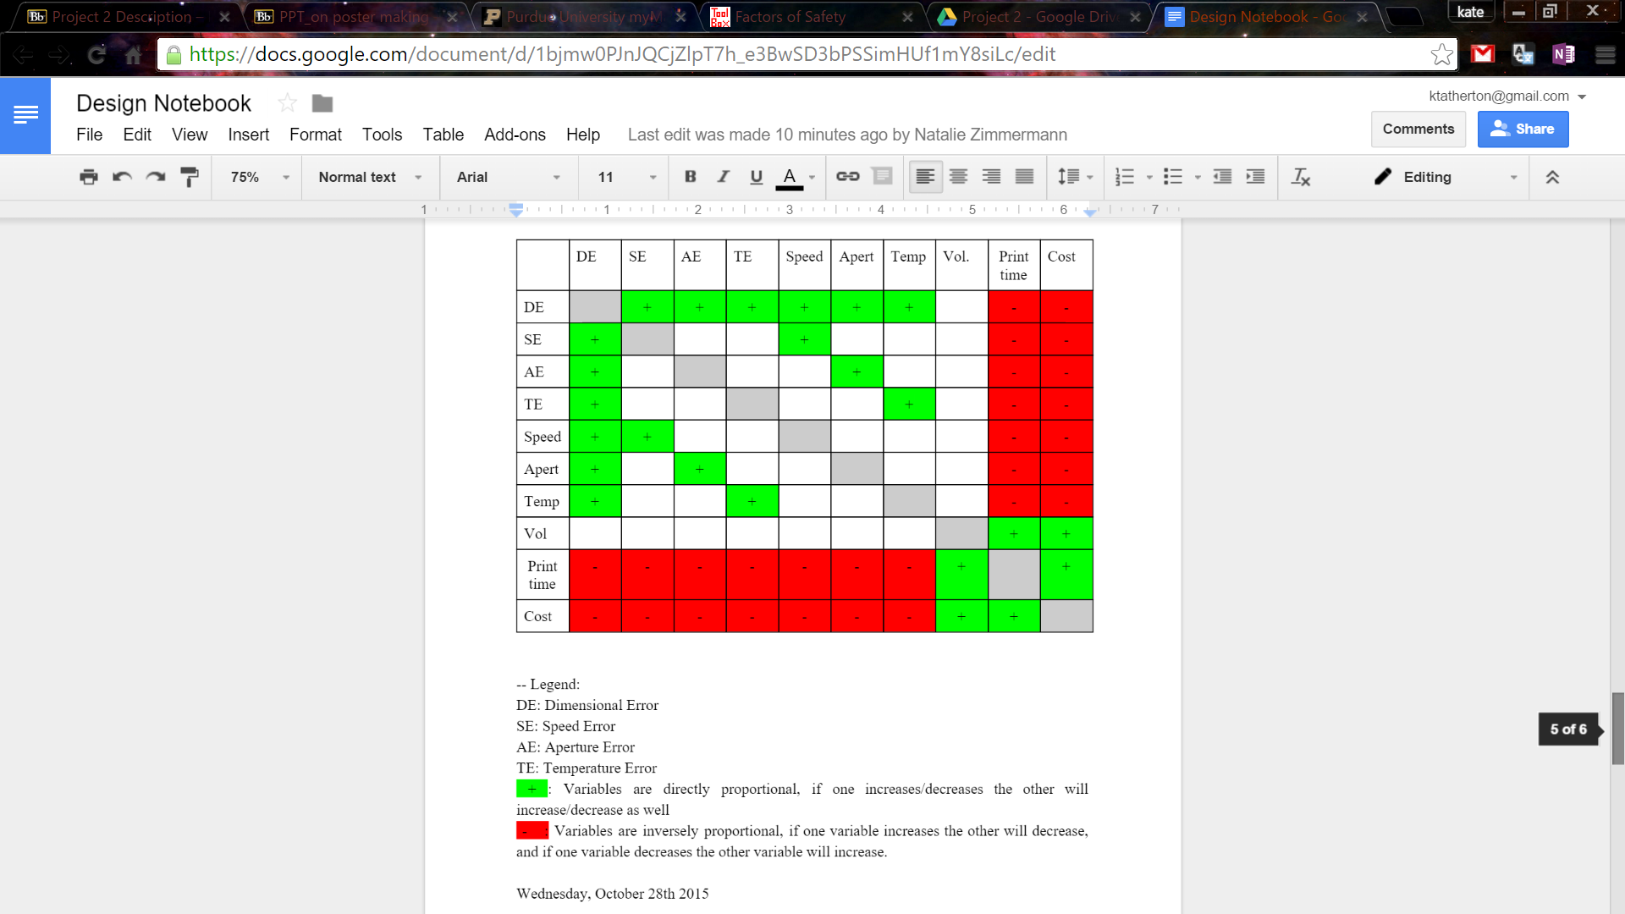
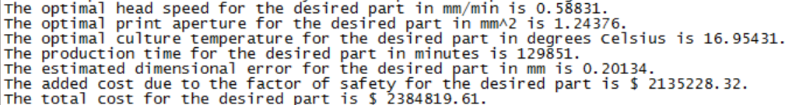
Modeling a Bioprinter
Kathryn Atherton, Ryan Hellyer, and Natalie Zimmermann
Purdue University, Purdue College of Engineering, Purdue Honors College
Introduction
Experimental Data
Factor of Safety
Bio-printing is a new subset of 3D printing that uses biomaterials to create parts for use in medicine.
The National Institute of Health (NIH) is funding companies to model a bio-printer in order to optimize its functions while reducing its cost.
Potential parts include cartilage, tracheal splints, aortic valves, vasculatures, and kidneys.
Each part has a different volume and tolerance for dimensional error that must be accounted for in the optimization of the bio-printer.
A mathematical model of the performance of the bio-printer, using data provided by the NIH, as well as recommend a Factor of Safety for the bio-printer’s use, was created to optimize the bio-printer.
The model must find the optimal printer head speed, print aperture, and culture temperature, as well as an approximate dimensional error, production time, cost, and additional cost due to the Factor of Safety.
b
To determine the Factor of Safety, the following factors were taken into account in the calculations:
Accuracy of the Regression Models
Ratio of Part Volume to Part Tolerance
Unforeseen External Factors
The average R² value for the regression models is 0.99552.
This means that the model cannot account for 0.448% of the experimental error from the known factors.
The ratios of part volume to part tolerance can be found in Table 1.
The higher the ratio between the volume and the part tolerance, the higher the factor of safety must be.
These ratios were made into proportions based on the other ratios, as seen in Table 1.
Unforeseen external factors will be accounted for by including an additional 30% of the Factor of Safety calculated from the foreseen error.
The formula for the Factor of Safety is [1 + (0.45)(Proportion)] * (1.3) * (100%)
Figure 2. Dimensional Error vs. Print Head Speed.
Linear Regression: y = 0.34224x
R² = 0.99002
Figure 3. Dimensional Error vs. Print Aperture.
Exponential Regression: y = 0.0054e^{2.9094x}
R² = 0.99849
Table 1. Determining Factor of Safety Data
Part | Ratio (mm³/mm) | Proportion
Cartilage | 6,000 | 1
Tracheal Splint | 20,000 | 3.33
Aortic Valve | 6,000 | 1
Vasculature | 20,000 | 3.33
Kidney | 63,333.33 | 10.56
Figure 1. Relationships Between Variables
Figure 4. Dimensional Error vs. Culture Temperature
Power Regression: y = 0.00002x^{3.2563}
R² = 0.99804
Table 2. Program Outputs
Part | Head Speed | Aperture | Temperature
Cartilage | 0.77 mm/min | 1.34 mm² | 18.44 ºC
Tracheal Splint | 0.04 mm/min | 0.36 mm² | 7.70 ºC
Aortic Valve | 0.39 mm/min | 1.10 mm² | 14.90 ºC
Vasculature | 0.22 mm/min | 0.91 mm² | 12.62 ºC
Kidney | 0.59 mm/min | 1.24 mm² | 16.95 ºC
Results
Table 3. Program Outputs Continued
The model receives inputs of part volume, tolerance, and Factor of Safety from a user.
An estimated dimensional error is found based on the Factor of Safety and part tolerance.
The regression lines are determined based on the cleaned, imported NIH data.
Values for the printer head speed, print aperture, and culture temperature are found with respect to the Factor of Safety, as well as the original part tolerance.
Printing and cure times are found for both situations (with and without respect to the Factor of Safety).
Respective production times for the part are then found.
The cost of production is calculated with and without the Factor of Safety taken into account.
The difference in cost between the two situations is found.
The program outputs the optimal print head speed, print aperture, culture temperature, and the approximate production time, dimensional error, added cost due to Factor of Safety, and the total cost for the part production. (See Figure 5)
The Factors of Safety that were determined for each part that the bio-printer will produce are as follows:
Cartilage: 189%
Tracheal Splints: 325%
Aortic Valves: 189%
Vasculature: 325%
Kidney: 745%
Part | Production Time | Dimensional Error | Added Cost | Total Cost
Cartilage | 2921 min | 0.26 mm | $28,477.73 | $54,085.82
Tracheal Splint | 618194 min | 0.02 mm | $9,516,560.56 | $11,132,500.35
Aortic Valve | 3550 min | 0.13 mm | $35,503.42 | $64,653.74
Vasculature | 24384 min | 0.08 mm | $345,086.00 | $441,413.72
Kidney | 129851 min | 0.20 mm | $2,135,228.32 | $2,384,519.61
Methods
AAMC first identified the variables that would affect the cost of operation, as well as the relationships between the variables (see Figure 1).
The data obtained from the NIH was then cleaned based on experimental notes provided with the data.
The cleaned data was then modeled in graphs to find the relationships between variables. Regression lines were developed with the Method of Least Squares, utilizing Microsoft Excel for non-linear models. (See Figures 2, 3, and 4).
Using this data, a mathematical model of the bio-printer performance was created in Python 3.
By analyzing the goodness of fit of the models of the experimental data, as well as taking into account external factors, a recommended Factor of Safety for each part was determined.
Conclusion
Part prices can range from ten-of-thousands to tens-of-millions based on the accuracy required and size of the part.
These recommended settings ensure that parts will be within specification, but as inexpensive as possible.
Figure 5. Example Program Output
Acknowledgements
We would like to extend our gratitude to the National Institute of Health for providing us with the generous grant, as well their performance data, that made the development of this model possible.
We would also like to thank our professor, Dr. Sean Brophy, for his guidance and patience in his lessons, our grad TA, Ted Danielson, for his useful Python Q&A sessions, our peer TA, Casey Schilling, for her helpful feedback, and our peer mentors, for keeping us motivated during Friday classes.

